Slide 1
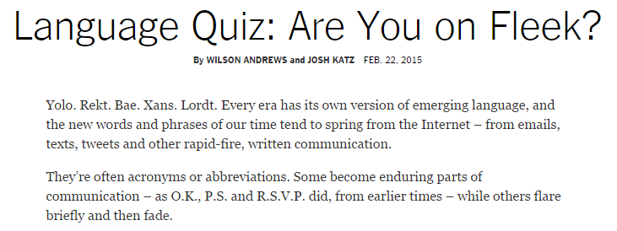
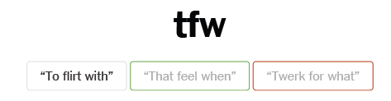
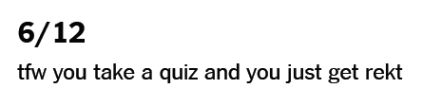
Speaking of language!?

Slide 2
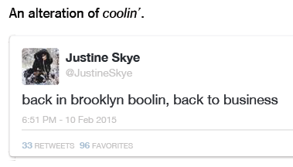
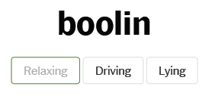

Slide 3
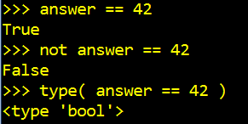
back to Python, boolin'…

Slide 4
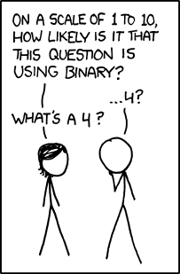
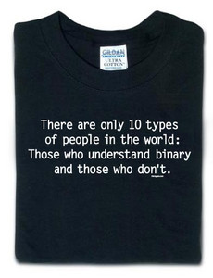
CS 101 Today...
Our top-10 list of binary jokes...
Jotto Corner
5C guess
ZD guess
HS guess
ZD guess
alien: 2
?????: ?
diner: 0
savvy: ?
?????: 0
?????: ?
diner: 2
savvy: ?
Reed
Jessica?
Looking Back Looking Forward
Computing as composition
Computing as representation
clay == functions
clay == data & bits

Slide 5
Some legs to stand on… ?
This is heady stuff!
decipher
max
encipher
sScore
letScore
rot(c,n)
program organization
creating more and more capable compositions
ord
chr

Slide 6
Some legs to stand on!
It looks like I'm ahead of this…
decipher
max
encipher
sScore
letScore
rot(c,n)
program organization
creating more and more capable compositions
ord
chr
bits!
circuits
computer organization
how are even these fundamentals physically realized ?!

Slide 7
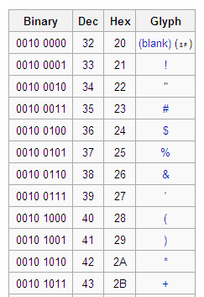
Binary Storage & Representation
8 bits = 1 byte = 1 box
value:
value:
'*'
42
00101010
00101010
type: str
bits
bits
type: int
name:
name:
But why these bits?
The same bits are in each container.
The SAME bits can represent different pieces of data, depending on type

Slide 8
42
What is 42 ?

Slide 9
Base 10
ONEs column
TENs column
42
What is 42 ?
4 tens + 2 ones
HUNDREDs column
TENs column
ONEs column
123
1 hundred + 2 tens + 3 ones

Slide 10
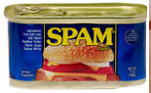
42
Value (semantics)
Syntax
stuff we care about (what things mean)
stuff we need to communicate

Slide 11
101010
different
SAME!
Value (semantics)
Syntax
stuff we care about (what things mean)
stuff we need to communicate

Slide 12
Base 2
Base 10
each column represents the base's next power
ONEs column
TENs column
THIRTYTWOs col.
EIGHTs column
SIXTEENs col.
FOURs column
TWOs column
ONEs column
42
101010
10
2
4 tens + 2 ones
123
128's column
HUNDREDs column
SIXTYFOURs col
THIRTYTWOs col.
EIGHTs column
SIXTEENs col.
FOURs column
TWOs column
ONEs column
TENs column
ONEs column
123
10
--------
1 hundred + 2 tens + 3 ones
Write 123 in binary…

Slide 13
Base 2
Base 10
each column represents the base's next power
ONEs column
TENs column
THIRTYTWOs col.
EIGHTs column
SIXTEENs col.
FOURs column
TWOs column
ONEs column
42
101010
4 tens + 2 ones
123
128's column
HUNDREDs column
SIXTYFOURs col
THIRTYTWOs col.
EIGHTs column
SIXTEENs col.
FOURs column
TWOs column
ONEs column
TENs column
ONEs column
123
--------
1 hundred + 2 tens + 3 ones
Write 123 in binary…

Slide 14
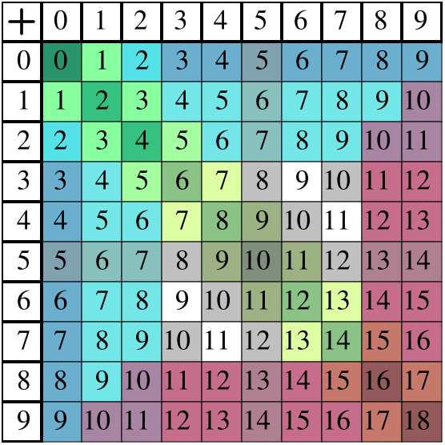
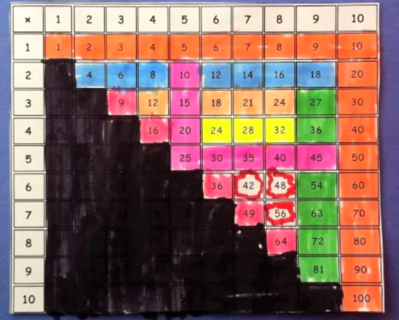
Binary math
Decimal math
tables of basic facts
+
Addition
*
Multiplication
www.youtube.com/watch?v=Nh7xapVB-Wk

Slide 15
Binary math
Decimal math
tables of basic facts
+
Addition
*
Multiplication
www.youtube.com/watch?v=Nh7xapVB-Wk

Slide 16
Binary math
Decimal math
tables of basic facts
+
Addition
*
Multiplication
www.youtube.com/watch?v=Nh7xapVB-Wk

Slide 17
Name(s): ______________________________
Quiz
In binary, I'm an 11-eyed alien!
32
16
8
4
2
1
110011
10001000
Convert these two binary numbers to decimal:
32
16
8
4
2
1
Convert these two decimal numbers to binary:
28
101
10
10
Add these two binary numbers:
Multiply these binary numbers:
101101
101101
*
1110
+
1110
WITHOUT converting to decimal !
+
529
*
1
Hint: Remember these algorithms? They're the same in binary!
42
529
1058
+
742
2116
1271
+
22218
Extra! Can you figure out the last binary digit (bit) of 53 without determining any other bits? The last two? 3?

Slide 18
Convert these two binary numbers to decimal:
32
16
8
4
2
1
128
64
32
16
8
4
2
1
110011
10001000
32 + 16 + 2 + 1
32 + 16 + 2 + 1
values in blue
51
51
Convert these two decimal numbers to binary:
28
101
10
32
16
8
4
2
1
128
64
32
16
8
4
2
1
syntax in orange
011100
01100101
Extra! Can you figure out the last binary digit (bit) of 53 without determining any other bits? The last two? 3?
We'll return to this in a bit…

Slide 19
Add these two binary numbers WITHOUT converting to decimal !
1
Hint:
529
32
16
8
4
2
1
+
742
Do you remember this algorithm? It's the same!
1271
101101
45
+
1110
14
59
32
16
8
4
2
1

Slide 20
Add these two binary numbers WITHOUT converting to decimal !
1
Hint:
529
+
742
Do you remember this algorithm? It's the same!
32
16
8
4
2
1
1271
101101
45
+
1110
14

Slide 21
Multiply these two binary numbers WITHOUT converting to decimal !
529
Hint:
*
42
Do you remember this algorithm? It's the same!
32
16
8
4
2
1
1058
101101
45
2116
+
*
1110
22218
14
A machine could - and probably should - be doing this !
630
Goal
Goal

Slide 22
Multiply these two binary numbers WITHOUT converting to decimal !
529
Hint:
*
42
Do you remember this algorithm? It's the same!
32
16
8
4
2
1
1058
101101
45
2116
+
*
1110
22218
14
000000
"partial products"
1011010
10110100
101101000
+
1001110110
A machine could - and probably should - be doing this !
630
512
256
128
64
32
16
8
4
2
1
Goal

Slide 23
Beyond Binary
base 1
digits: 1
111111111111111111111111111111111111111111
32
16
8
4
2
1
101010
base 2
digits: 0, 1
27
9
3
1
base 3
digits: 0, 1, 2
42 ?
There are 10 kinds of "people" in the universe: those who know ternary, those who don't, and those who think this is a binary joke!

Slide 24
Beyond Binary
base 1
digits: 1
111111111111111111111111111111111111111111
32
16
8
4
2
1
101010
base 2
digits: 0, 1
27
9
3
1
1120
base 3
digits: 0, 1, 2
16
4
1
base 4
base 5
Which of these isn't 42...?
base 6
222
60
54
46
39
base 7
base 8
and what are the bases of the rest?
base 9
base 10
42
digits: 0, 1, 2, 3, 4, 5, 6, 7, 8, 9
base 11
base 12
. . .
base 16

Slide 25
Beyond Binary
base 1
digits: 1
111111111111111111111111111111111111111111
32
16
8
4
2
1
101010
base 2
digits: 0, 1
27
9
3
1
1120
base 3
digits: 0, 1, 2
16
4
1
base 4
base 5
Which of these isn't 42...?
base 6
222
60
54
46
39
base 7
base 8
and what are the bases of the rest?
base 9
base 10
42
digits: 0, 1, 2, 3, 4, 5, 6, 7, 8, 9
base 11
base 12
. . .
base 16

Slide 26
base 1
digits: 1
All 42s!
111111111111111111111111111111111111111111
128
64
32
16
8
4
2
1
101010
base 2
digits: 0, 1
81
27
9
3
1
1120
base 3
digits: 0, 1, 2
64
16
4
1
base 4
digits: 0, 1, 2, 3
222
125
25
5
1
base 5
digits: 0, 1, 2, 3, 4
132
216
36
6
1
base 6
digits: 0, 1, 2, 3, 4, 5
110
49
7
1
base 7
digits: 0, 1, 2, 3, 4, 5, 6
60
64
8
1
base 8
52
digits: 0, 1, 2, 3, 4, 5, 6, 7
81
9
1
base 9
46
digits: 0, 1, 2, 3, 4, 5, 6, 7, 8
100
10
1
base 10
42
digits: 0, 1, 2, 3, 4, 5, 6, 7, 8, 9
121
11
1
base 11
39
digits: 0, 1, 2, 3, 4, 5, 6, 7, 8, 9, A
Hexadecimal
256
16
1
base 16
2A
digits: 0, 1, 2, 3, 4, 5, 6, 7, 8, 9, A, B, C, D, E, F

Slide 27
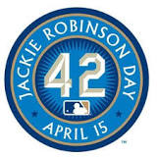
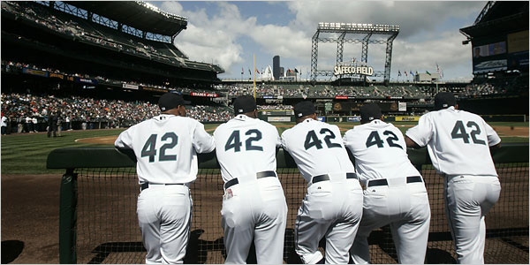
base 1
digits: 1
All 42s!
111111111111111111111111111111111111111111
128
64
32
16
8
4
2
1
101010
base 2
digits: 0, 1
81
27
9
3
1
1120
base 3
digits: 0, 1, 2
64
16
4
1
base 4
digits: 0, 1, 2, 3
222
125
25
5
1
base 5
digits: 0, 1, 2, 3, 4
132
216
36
6
1
base 6
digits: 0, 1, 2, 3, 4, 5
110
49
7
1
base 7
digits: 0, 1, 2, 3, 4, 5, 6
60
64
8
1
base 8
52
digits: 0, 1, 2, 3, 4, 5, 6, 7
81
9
1
base 9
46
digits: 0, 1, 2, 3, 4, 5, 6, 7, 8
100
10
1
base 10
42
digits: 0, 1, 2, 3, 4, 5, 6, 7, 8, 9
121
11
1
base 11
39
digits: 0, 1, 2, 3, 4, 5, 6, 7, 8, 9, A
Hexadecimal
256
16
1
base 16
2A
digits: 0, 1, 2, 3, 4, 5, 6, 7, 8, 9, A, B, C, D, E, F

Slide 28
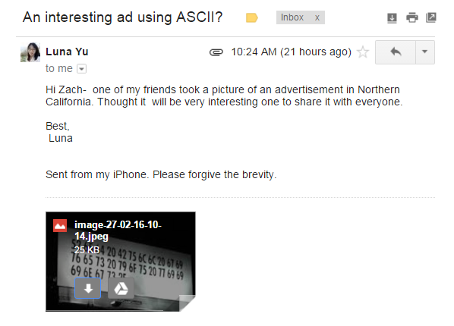
base 1
digits: 1
All 42s!
111111111111111111111111111111111111111111
128
64
32
16
8
4
2
1
101010
base 2
digits: 0, 1
81
27
9
3
1
1120
base 3
digits: 0, 1, 2
64
16
4
1
base 4
digits: 0, 1, 2, 3
222
125
25
5
1
base 5
digits: 0, 1, 2, 3, 4
132
216
36
6
1
base 6
digits: 0, 1, 2, 3, 4, 5
110
49
7
1
base 7
digits: 0, 1, 2, 3, 4, 5, 6
60
64
8
1
base 8
52
digits: 0, 1, 2, 3, 4, 5, 6, 7
81
9
1
base 9
46
digits: 0, 1, 2, 3, 4, 5, 6, 7, 8
100
10
1
base 10
42
digits: 0, 1, 2, 3, 4, 5, 6, 7, 8, 9
121
11
1
base 11
39
digits: 0, 1, 2, 3, 4, 5, 6, 7, 8, 9, A
Hexadecimal
256
16
1
base 16
2A
digits: 0, 1, 2, 3, 4, 5, 6, 7, 8, 9, A, B, C, D, E, F

Slide 29
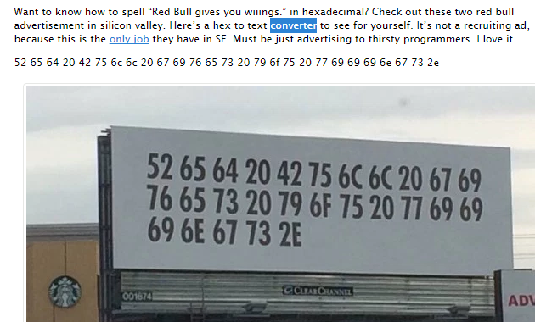
base 1
digits: 1
All 42s!
111111111111111111111111111111111111111111
128
64
32
16
8
4
2
1
101010
base 2
digits: 0, 1
81
27
9
3
1
1120
base 3
digits: 0, 1, 2
64
16
4
1
base 4
digits: 0, 1, 2, 3
222
125
25
5
1
base 5
digits: 0, 1, 2, 3, 4
132
216
36
6
1
base 6
digits: 0, 1, 2, 3, 4, 5
110
49
7
1
base 7
digits: 0, 1, 2, 3, 4, 5, 6
60
64
8
1
base 8
52
digits: 0, 1, 2, 3, 4, 5, 6, 7
81
9
1
base 9
46
digits: 0, 1, 2, 3, 4, 5, 6, 7, 8
100
10
1
base 10
42
digits: 0, 1, 2, 3, 4, 5, 6, 7, 8, 9
121
11
1
base 11
39
digits: 0, 1, 2, 3, 4, 5, 6, 7, 8, 9, A
Hexadecimal
256
16
1
base 16
2A
digits: 0, 1, 2, 3, 4, 5, 6, 7, 8, 9, A, B, C, D, E, F

Slide 30
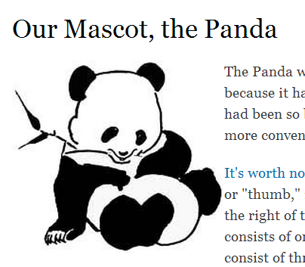
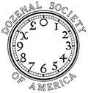
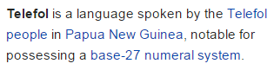
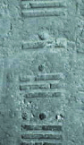
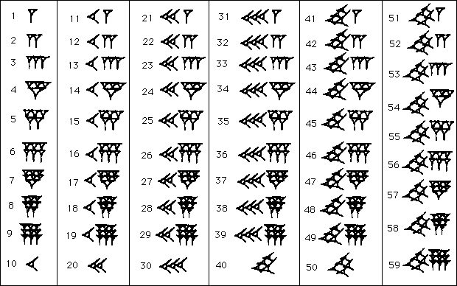
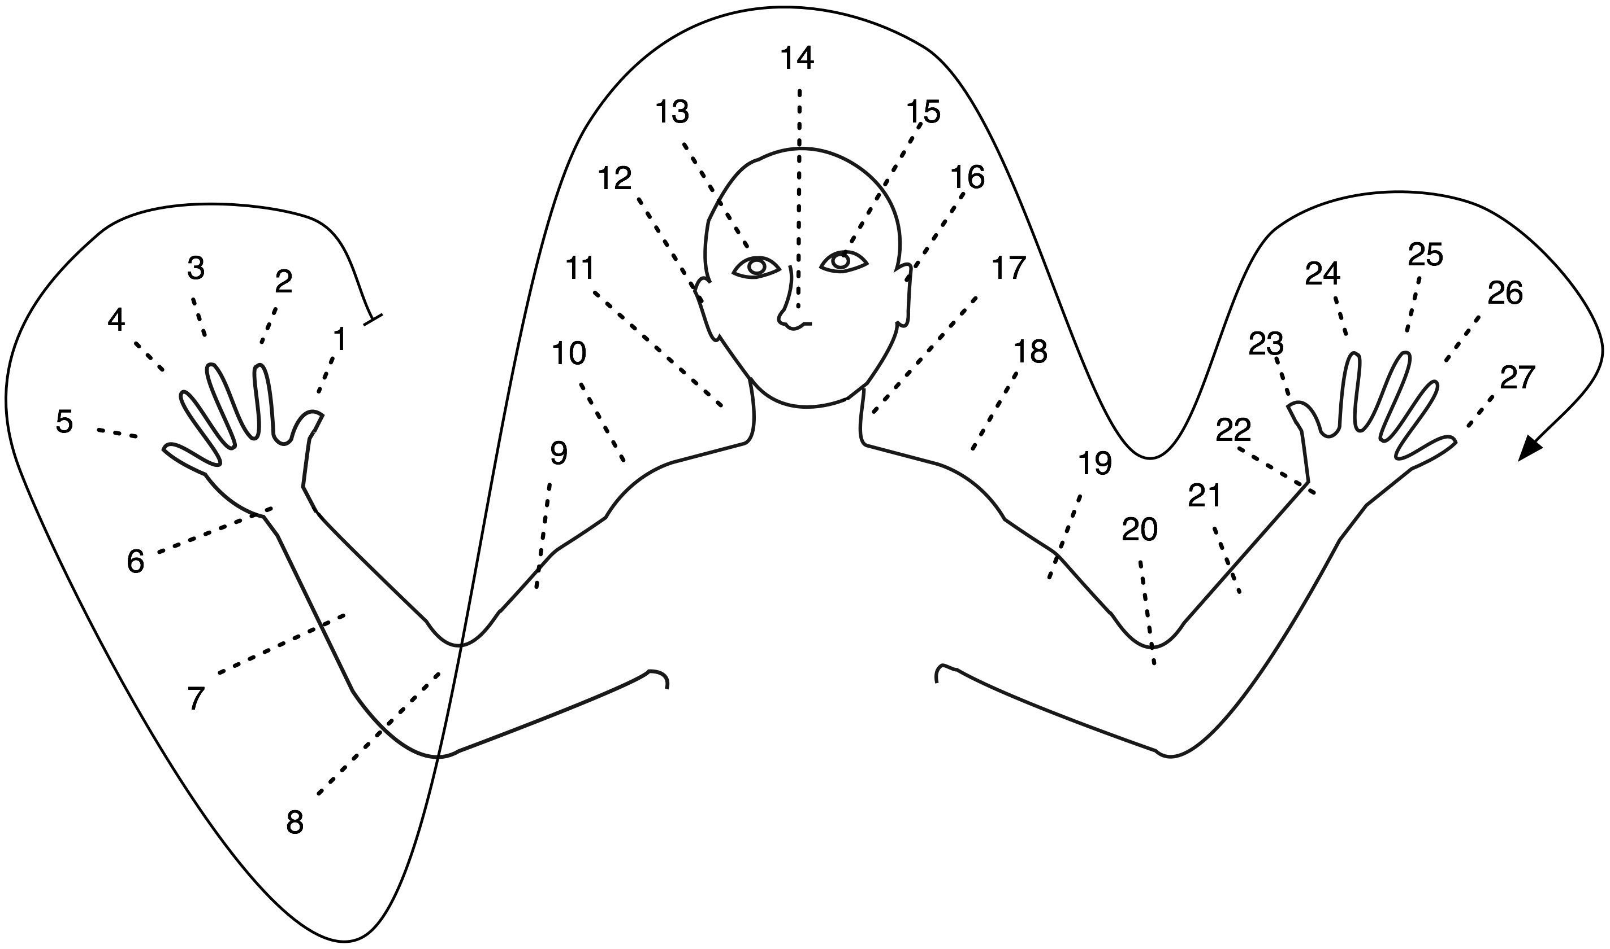
Off base?
Base 12 –
"Duodecimal Society" "Dozenal Society"
Base 20: Americas
Base 60 – Ancient Sumeria
6
16
Base 27: New Guinea
Olmec base-20 numbers
E. Mexico, ~ 300 AD
Some of these bases are still echoing around…
Notes:
Echoes:
dozen, gross -- show donzenal society pages:
http://www.dozenal.org/index.php?u=31
http://www.polar.sunynassau.edu/~dozenal/
British units: 12 inches, 12 ounces (Latin: uncia)
time: 12 hours
60: seconds, minutes, circular arcs -- from a 360 day calendar of the ancient sumerians and babylonians (circle of the sun going around the earth)
base 20 -- even though there is no evidence in Europe…
fingers + toes
"four score and seven years ago"
languages exhibit it:
French
Twenty (vingt) is used as a base number in the French language names of numbers from 60 to 99. So for example, quatre-vingts, the French word for 80 literally means "four twenties", and soixante quinze, the word for 75 is literally "sixty-fifteen.").

Slide 31
But why binary?

Slide 32
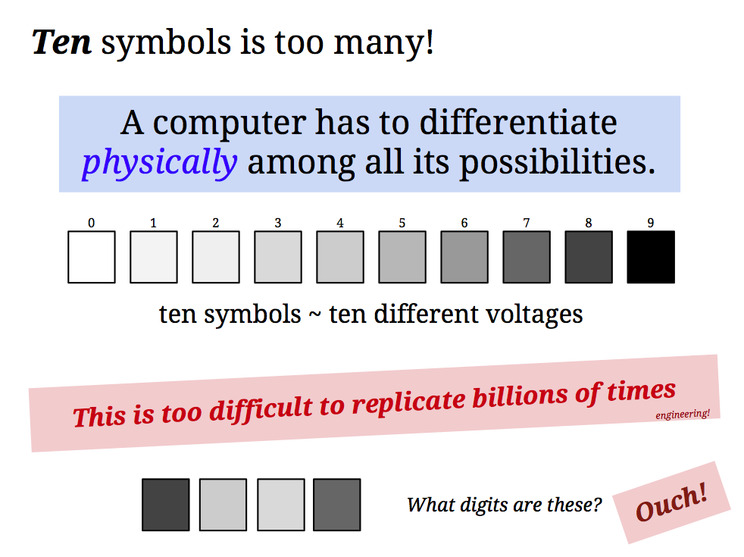

Slide 33
8 4 7 3

Slide 34
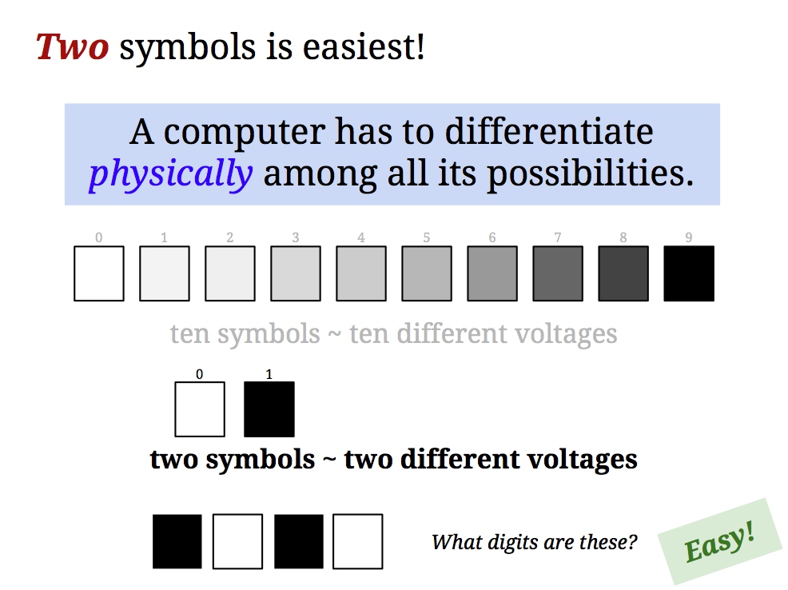
But why binary ?

Slide 35
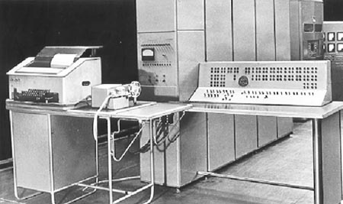
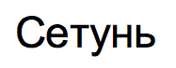
Ternary computers?
Everything should be base-3!
50 of these Setun ternary machines were made at Moscow U. ~ 1958
This project was discontinued in 1970… though not because of the ternary design!

Slide 36
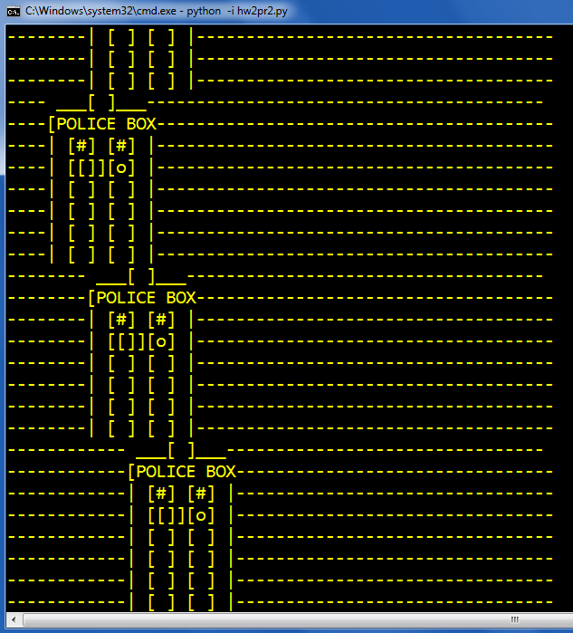
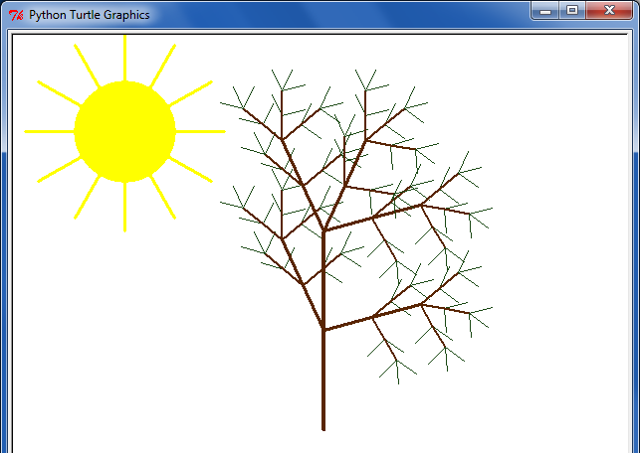
Eye-catching submissions...
and turtle art
ASCII wanderings...

Slide 37
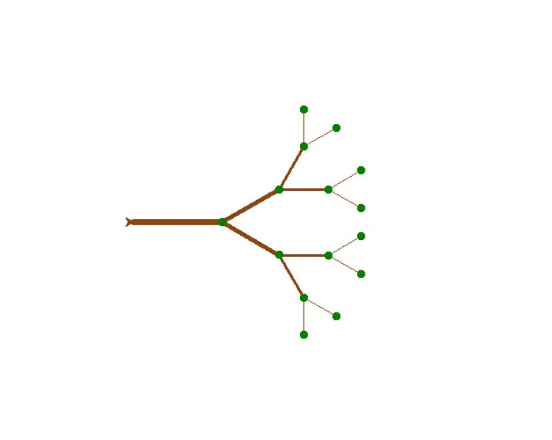
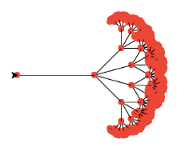
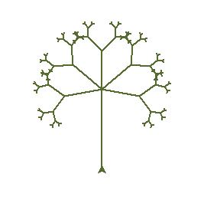
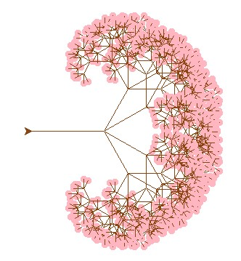
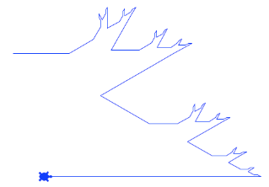
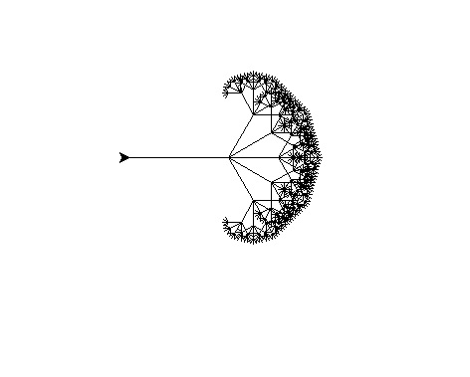
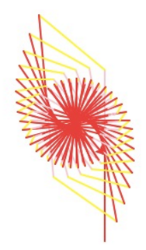
Trees...
Elizabeth M.
Alana G.
Anant K.
Darren L
Ali O.
ChongHyeon J.
Yuexi L.

Slide 38
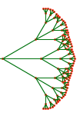
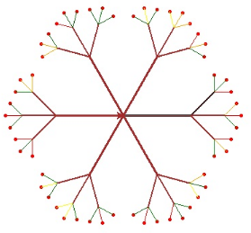
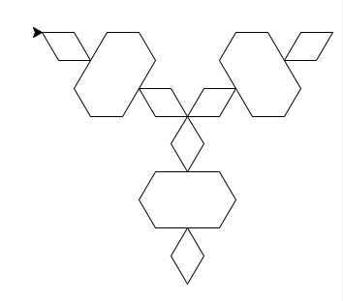
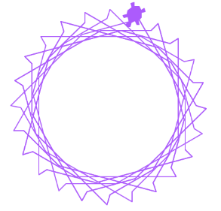
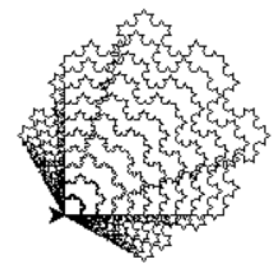
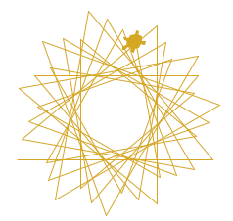
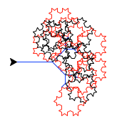
Spirals...
Emi S.
Aathmika K.
Celine P
Henrietta T.
James R.
Peter B.

Slide 39
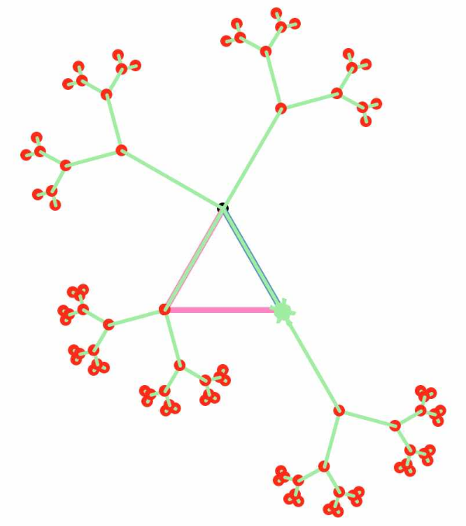
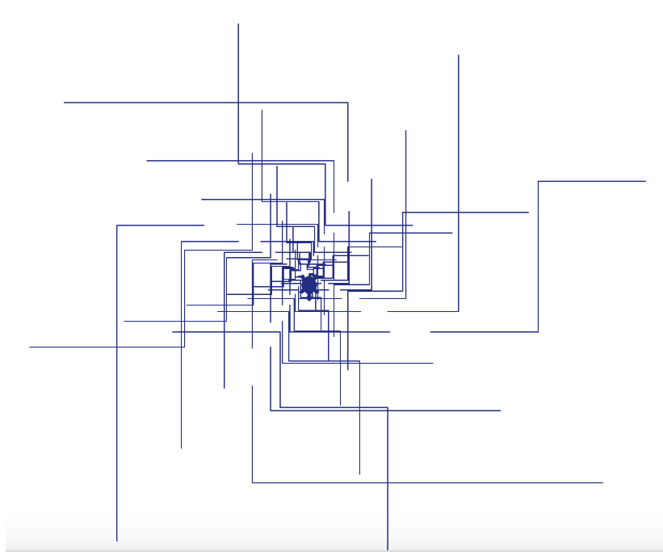
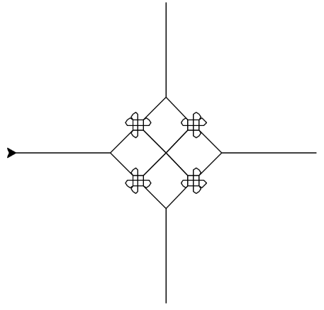
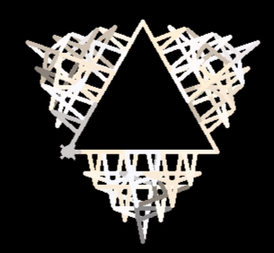
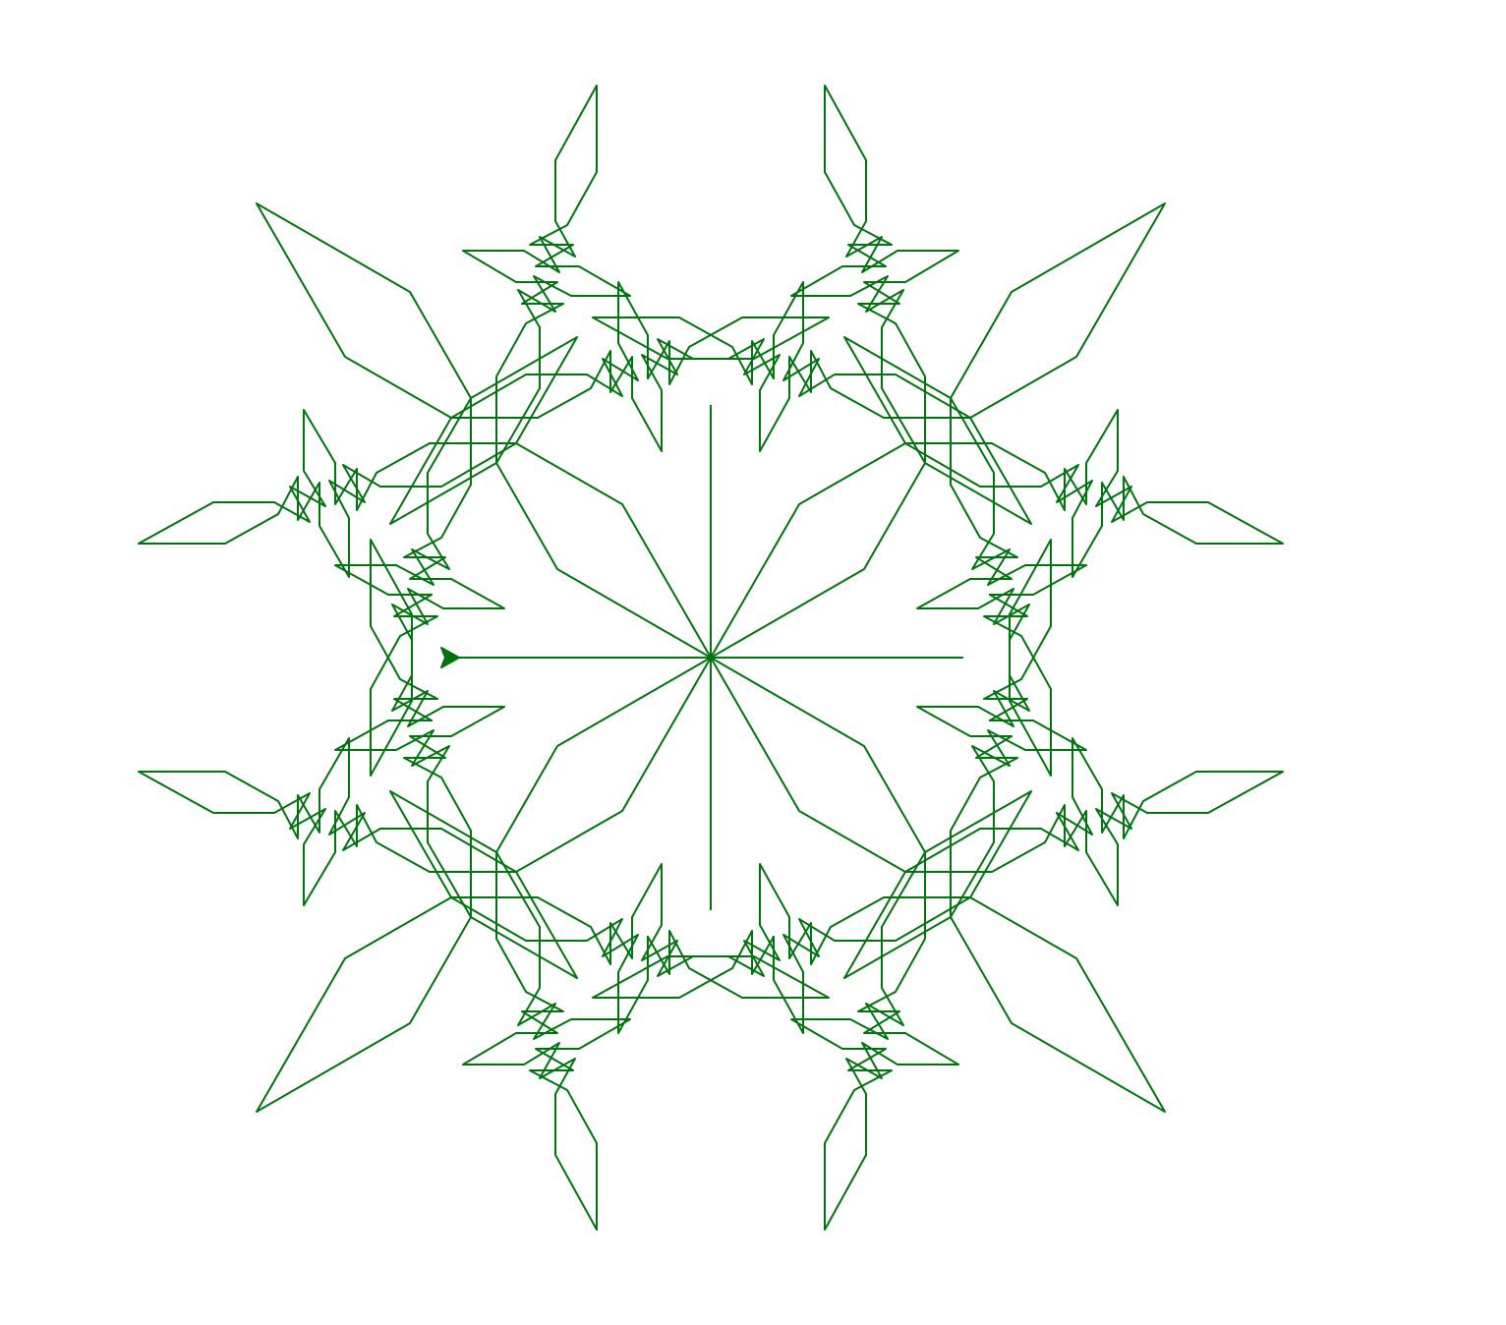
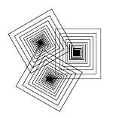
Both!?
Celine P.
Evelyn M.
Brendan S.
Liz H.
Lilian H.
Wenhao Z.

Slide 40
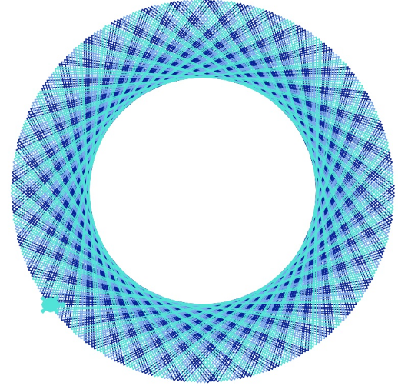
!!!
Dory L.

Slide 41
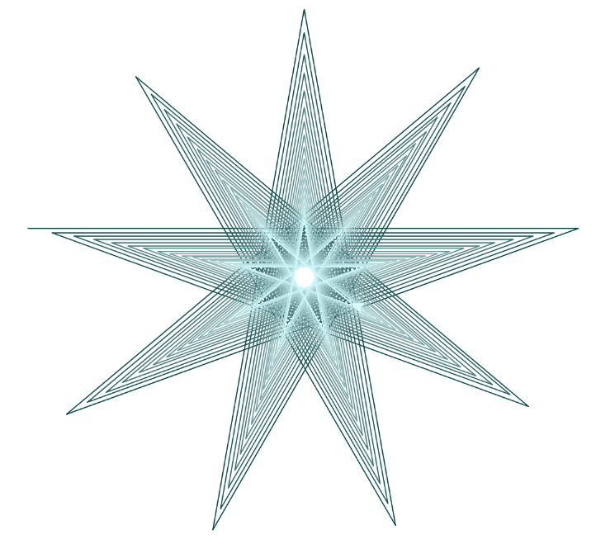
!!!
Eliana K. + Emily C.

Slide 42



Slide 43











Hannah Slocumb
Sloan Cinelli
Well-named images!
R. Kim
Kepa Barrett

Slide 44





Jeni Z.
Well-named images!
Julie K.
Maya T.
Peter A.
Vaiva P.

Slide 45





Vivian Z.
Carly M.
Eliana K. + Emily C.
Hannah L.

Slide 46

Jeni Z.
Well-named images!
Julie K.
Maya T.
Peter A.
Vaiva P.

Slide 47




Elisabeth M.
Kris B.
Forest K.
No-name-needed images!
Lilian H.

Slide 48


Snowflake?
svtree?
It all depends on how you define success ...

Slide 49



Samantha Richards
treefail3.png
Snowflake?
svtree?
It all depends on how you define success ...

Slide 50

Samantha Richards
treefail3.png
Snowflake?
svtree?
It all depends on how you define success ...
SNOWFLAKE?!

Slide 51

Whoa!
'12
a turtle-drawn portrait from turtle graphics …

Slide 52

Whoa!
'15
New in 2015… !
Turtle Movies…
Montana R.

Slide 53
Back to bits…
not the original name...

Slide 54

b.d. ~ binary digit ~ bit
"bit" first appeared in print in 1948 (Claude Shannon)
early document allocating different bits to control or data portions of a processor's work
Extra! Can you figure out the last binary digit (bit) of 53 without determining any earlier bits? The last two? three?
All of them?

Slide 55
Lab 4: Computing in binary
base 2
base 10
…
4
2
1
100
10
1
=
141
This first step of left-to-right conversion into binary is tricky to program... Why?
You mean aside from having to think in binary?

Slide 56
Lab 4: Computing in binary
base 2
base 10
128
64
32
16
8
4
2
1
100
10
1
=
141
This first step of left-to-right conversion into binary is tricky to program... Why?
It's tricky to find the largest power needed…

Slide 57
in the end, we need "53"-worth of value
53
…
32s
16s
8s
4s
2s
1s
top-level reality!
…
16s
8s
4s
2s
1s
"next"-level reality...
…
8s
4s
2s
1s
…
4s
2s
1s
2s
1s
bits!
53
value remaining
Extra! Can you figure out the last binary digit (bit) of 53 without determining any earlier bits? The last two? three?
All of them?

Slide 58
in the end, we need "53"-worth of value
53
…
32s
16s
8s
4s
2s
1s
top-level reality!
…
16s
8s
4s
2s
1s
"next"-level reality...
…
8s
4s
2s
1s
…
4s
2s
1s
2s
1s
bits!
53
value remaining
Extra! Can you figure out the last binary digit (bit) of 53 without determining any earlier bits? The last two? three?
All of them?

Slide 59
Extra! Can you figure out the last binary digit (bit) of 53 without determining any other bits? The last two? 3?
All?
…
32s
16s
8s
4s
2s
1s
top-level reality!
…
16s
8s
4s
2s
1s
…
8s
4s
2s
1s
…
4s
2s
1s
2s
1s
in the end, we need "53"-worth of value
53

Slide 60
Extra! Can you figure out the last binary digit (bit) of 53 without determining any other bits? The last two? 3?
All?
…
32s
16s
8s
4s
2s
1s
top-level reality!
…
16s
8s
4s
2s
1s
…
8s
4s
2s
1s
…
4s
2s
1s
2s
1s
in the end, we need "53"-worth of value
53

Slide 61
Extra! Can you figure out the last binary digit (bit) of 53 without determining any other bits? The last two? three?
All?
…
?s
?s
?s
?s
in the end, we need "53"-worth of value
53

Slide 62
Extra! Can you figure out the last binary digit (bit) of 53 without determining any other bits? The last two? three?
All?
…
?s
?s
?s
?s
in the end, we need "53"-worth of value
53

Slide 63
Lab 4: Converting to binary…
base 10
base 2
100
10
1
128
64
32
16
8
4
2
1
141
=
What does the fact that 141 is ODD tell us?!
Try right-to-left!
141
=
10001101
answer
128
64
32
16
8
4
2
1

Slide 64
Lab 4: Converting to binary…
base 10
base 2
100
10
1
128
64
32
16
8
4
2
1
141
=
What does the fact that 141 is ODD tell us?!
Try right-to-left!
141
=
10001101
answer
128
64
32
16
8
4
2
1

Slide 65
Lab 4: Computing in binary
base 10
base 2
100
10
1
128
64
32
16
8
4
2
1
141
=
'10001101'
Right-to-left works!
numToBinary( N )
binaryToNum( S )
You'll write these right! (-to-left)
we need to represent binary numbers with strings
n2b(141)
b2n('10001101')

Slide 66
Lab 4: Computing in binary
base 10
base 2
100
10
1
128
64
32
16
8
4
2
1
141
=
'10001101'
def numToBinary( N ):
if N == 0:
return ''
elif N%2 == 0:
return numToBinary( ) +
else:
return numToBinary( ) +
empty string means 0
If N is even, what is the final bit?
?
If N is odd, what is the final bit?
How much VALUE is left to convert!?

Slide 67
Lab 4: Fleek binary conversion !
def numToBinary( N ):
if N == 0: return ''
else: return numToBinary(N//2) +
def numToBinary( N ):
if N == 0:
return ''
elif N%2 == 0:
return numToBinary( N//2 )+ '0'
else:
return numToBinary( N//2 )+ '1'
empty string means 0
If N is even, what is the final bit?
If N is odd, what is the final bit?
How much VALUE is left to convert!?

Slide 68
Reasoning, bit by bit
<<
>>
&
|
left-shift
right-shift
and
or
and
(both)
&
|
or
(either)
bitwise and
bitwise and
5: 101
5 & 6
11: 1011
11 & 5
6: 110
5: 0101
4
1
& 100
& 0001
bitwise or
bitwise or
5 | 6
11: 1011
11 | 5
5: 101
6: 110
5: 0101
7
7
| 111
| 1111

Slide 69
Reasoning, bit by bit
<<
>>
&
|
left-shift
right-shift
and
or
left-shift by 1
11
3 << 1
110
6
What does left-shifting do to the value of a #?
left-shift by 2
11
3 << 2
1100
12
What does right-shifting do to the value of a #?
right-shift by 1
101010
42 >> 1
10101
21
42 >> 2 ?

Slide 70
Being bit-wise
Try these for a bit…
You don't need to convert to binary for these three…
14: 1110
9: 1001
You do need to use binary for these two!
7 << 1
left-shift
14 | 9
5 << 4
or
14 & 9
170 >> 2
right-shift
and
In processors shifts, ands, ors, adds, and subtractions are very fast, whereas multiplying, dividing, and mod, which are relatively slow.
N//4
Given this, what is a way to compute these expressions using only fast operations, maybe in combination?
N*7
N*17
N%16
extra fleek!

Slide 71
Being bit-wise
Try these for a bit…
You don't need to convert to binary for these three…
14: 1110
9: 1001
You do need to use binary for these two!
7 << 1
14
left-shift
14 | 9
15
5 << 4
80
or
1111
42
14 & 9
8
170 >> 2
and
1000
right-shift
In processors shifts, ands, ors, adds, and subtractions are very fast, whereas multiplying, dividing, and mod, which are relatively slow.
N//4
Given this, what is a way to compute these expressions using only fast operations, maybe in combination?
N*7
Let's first look at why you'd bother … !?
N*17
N%16
extra fleek!

Slide 72



Intel x86 processor instructions and their speeds (2016)
first time in a row
rest of times (in a row)
In processors shift, and, or, add, and subtract are much faster than multiply, divide, and mod, which are relatively slow.
MOD is the same
Old Microsoft systems-interview question, #42:

Slide 73
Intel x86 processor instructions and their speeds (2014)
In processors shift, and, or, add, and subtract are much faster than multiply, divide, and mod, which are relatively slow.
MOD is the same
N/4
N >> 2
Given this, what is a way to compute these statements using combinations from only the fast operations above?
N*7
N*17
N%16

Slide 74

Insight: Ancient Egyptian Multiplication
Next time?
Notes:
This algorithm for multiplying two numbers was evidently widely used by peasants in Russia into the 19th century and is evidently still used in some parts of Russia!
The algorithm goes like this: Write down the two numbers side-by-side. In this case, 21 and 6. Then divide 21 by 2 (rounding down) and multiply 6 by 2. Repeat this process until the number in the left column becomes 1. Then, highlight those rows in which the first number is odd. In those rows, collect all the number in the second column and add them up. That’s the desired product!

Slide 75

Insight: Ancient Egyptian Multiplication
AEM/RPM algorithm
21 × 6 == 126
Write the factors in two columns.
Repeatedly halve the LEFT and double the RIGHT. (toss remainders…)
Pull out the RIGHT values where the LEFT values are odd.
Sum those values for the answer!
21 6
Why does this work?
11 × 15 == 165
Try it here
11 15
Buddy, can you spare an eye?
or RPM...
Notes:
This algorithm for multiplying two numbers was evidently widely used by peasants in Russia into the 19th century and is evidently still used in some parts of Russia!
The algorithm goes like this: Write down the two numbers side-by-side. In this case, 21 and 6. Then divide 21 by 2 (rounding down) and multiply 6 by 2. Repeat this process until the number in the left column becomes 1. Then, highlight those rows in which the first number is odd. In those rows, collect all the number in the second column and add them up. That’s the desired product!

Slide 76

This room is a 10!
When traveling, always insist on binary accommodations … !
See you at lab – in just a bit!

Slide 78
Insight: Multiplication in binary w/o bits!
110
10101
6
x
21
21 6
10 12
5 24
2 48
1 96
110
0000
11000
000000
1100000
6
24
96
6
12
24
48
+
96
+
1111110
126
126
Decimal
Binary
Notes:
To see why it works, let’s convert the numbers in both columns to binary.

Slide 79
Insight: Multiplication in binary w/o bits!
1111
1011
15
x
11
11 15
5 30
2 60
1 120
1111
11110
000000
1111000
15
30
120
15
30
60
+
120
+
10100101
165
165
Decimal
Binary
Notes:
To see why it works, let’s convert the numbers in both columns to binary.

Slide 80

Insight: Egyptian + Russian Multiplication
1111
1011
15
x
11
11 15
5 30
2 60
1 120
1111
11110
000000
1111000
15
30
120
15
30
60
+
120
+
10100101
165
165
Decimal
Binary
Notes:
To see why it works, let’s convert the numbers in both columns to binary.

Slide 81



Sarah Hiller
Well-named images!
Jerry Jiang
Ryan Piantedosi
Cosette Dwyer

Slide 82
Hannah Slocumb
Sloan Cinelli
Well-named images!
R. Kim
Kepa Barrett

Slide 83

Trees!

Slide 84
Base 2
Base 10
each column represents the base's next power
ONEs column
TENs column
THIRTYTWOs col.
EIGHTs column
SIXTEENs col.
FOURs column
TWOs column
ONEs column
42
101010
4 tens + 2 ones
128's column
HUNDREDs column
SIXTYFOURs col
THIRTYTWOs col.
EIGHTs column
SIXTEENs col.
FOURs column
TWOs column
ONEs column
TENs column
ONEs column
123
--------
1 hundred + 2 tens + 3 ones
Write 123 in binary…

Slide 85
Extra! Can you figure out the last binary digit (bit) of 53 without determining any other bits? The last two? three?
All?
…
8s
4s
2s
1s
53

Slide 86
Binary math
Decimal math
tables of basic facts
+
Addition
*
Multiplication
www.youtube.com/watch?v=Nh7xapVB-Wk

Slide 87
Reasoning, bit by bit
<<
>>
Python did always look a little shifty to me…
left-shift
right-shift
left-shift by 1
11
3 << 1
6
What does left-shifting do to the value of a #?
left-shift by 2
11
3 << 2
What does right-shifting do to the value of a #?
right-shift by 2
101010
42 >> 2
5 & 6
5 | 6

Slide 88
Insight: Ancient Egyptian Multiplication
AEM/RPM algorithm
21 × 6 == 126
Write the factors in two columns.
Repeatedly halve the LEFT and double the RIGHT. (toss remainders…)
Pull out the RIGHT values where the LEFT values are odd.
Sum those values for the answer!
21 6
Why does this work?
11 × 15 == 165
Try it here
11 15
Buddy, can you spare an eye?
or Russian Peasants' Multiplication
Notes:
This algorithm for multiplying two numbers was evidently widely used by peasants in Russia into the 19th century and is evidently still used in some parts of Russia!
The algorithm goes like this: Write down the two numbers side-by-side. In this case, 21 and 6. Then divide 21 by 2 (rounding down) and multiply 6 by 2. Repeat this process until the number in the left column becomes 1. Then, highlight those rows in which the first number is odd. In those rows, collect all the number in the second column and add them up. That’s the desired product!

Slide 89
Being bit-wise
Try these on the back page first…
You don't need to convert to binary for these three…
14: 1110
9: 1001
You do need to use binary for these two!
7 << 1
left-shift
14 | 9
5 << 4
or
14 & 9
170 >> 2
right-shift
and
In processors shifts, ands, ors, adds, and subtractions are much faster than multiplying, dividing, and mod, which are relatively slow.
N/4
Given this, what is a way to compute these expressions using only combinations of the fast operations above?
N*7
N*17
N%16
extra fleek!

Slide 90
Being bit-wise
Try these on the back page first…
You don't need to convert to binary for these three…
14: 1110
13: 1011
You will need to use binary here!
7 << 1
5 << 4
14 & 13
14 | 13
170 >> 2
In processors shifts, ands, ors, adds, and subtractions are much faster than multiplying, dividing, and mod, which are relatively slow.
N/4
Given this, what is a way to compute these statements using combinations from only the fast operations above?
N*7
Let's first look at why you'd bother … !?
N*17
N%16

Slide 91
Being bit-wise
Try these on the back page first…
You don't need to convert to binary for these three…
14: 1110
13: 1011
You will need to use binary here!
7 << 1
5 << 4
14 & 13
14 | 13
170 >> 2
In processors shifts, ands, ors, adds, and subtractions are much faster than multiplying, dividing, and mod, which are relatively slow.
N/4
Given this, what is a way to compute these statements using combinations from only the fast operations above?
N*7
N*17
N%16

Slide 92




Thomas Fowler's Ternary Computer
finally some sanity in human computing!
balanced ternary calculations from Fowler's papers
the carry mechanism
the reconstruction
the computational components
T. Fowler 1777-1843, Treasurer of the Poor Law Union
Notes:
http://www.mortati.com/glusker/fowler/fowlerbio.htm
"In the 1830’s, Fowler was Treasurer of the Poor Law Union. This job required a considerable number of repetitive monetary calculations, made more complex by the pre-decimal British currency."

Slide 93

The machine was rebuilt from two sources:
a two-page description (with no images) by mathematician A. DeMorgan
http://www.mortati.com/glusker/fowler/index.htm

Slide 94

The machine was rebuilt from two sources:
a two-page description (with no images) by mathematician A. DeMorgan
a picture of it as a stained-glass window in Fowler's church: St. Michael's of Great Torrington, North Devon, U.K.!
http://www.mortati.com/glusker/fowler/index.htm

Slide 95





Both!?
Maggie Li
K. Mayer
Leah S.
Earl Schultz

Slide 96

Alice S.
Will P.

Slide 97




Curtis S.
Yi Li
Alex Waggoner
Alex Pachter

Slide 98

Grutoring…
Th. @ 5:30pm…
Matt Bae

Slide 99
This week's homework may be submitted in two formats: electronically or in stained glass.
See you in Lab!

Slide 101
Insight: Multiplication with Russian Peasants
21 × 6 == 126
Write the factors in two columns.
Repeatedly halve the LEFT and double the RIGHT.
Pull out the RIGHT values where the LEFT values are odd.
Sum those values for the answer.
21 6
Try it. Why does it work?
11 × 15 == 165
11 15
Hey, buddy, can you spare an eye?
(Translation: “Hello, American Students!” I've been told there's a typo here, too!)
Notes:
This algorithm for multiplying two numbers was evidently widely used by peasants in Russia into the 19th century and is evidently still used in some parts of Russia!
The algorithm goes like this: Write down the two numbers side-by-side. In this case, 21 and 6. Then divide 21 by 2 (rounding down) and multiply 6 by 2. Repeat this process until the number in the left column becomes 1. Then, highlight those rows in which the first number is odd. In those rows, collect all the number in the second column and add them up. That’s the desired product!

Slide 102
Base 2
Base 10
each column represents the base's next power
ONEs column
TENs column
THIRTYTWOs col.
EIGHTs column
SIXTEENs col.
FOURs column
TWOs column
ONEs column
42
101010
4 tens + 2 ones
128's column
HUNDREDs column
SIXTYFOURs col
THIRTYTWOs col.
EIGHTs column
SIXTEENs col.
FOURs column
TWOs column
ONEs column
TENs column
ONEs column
123
--------
1 hundred + 2 tens + 3 ones
Write 123 in binary…

Slide 103
Binary math
Decimal math
tables of basic facts
+
Addition
*
Multiplication
www.youtube.com/watch?v=Nh7xapVB-Wk

Slide 104
Convert these two binary numbers to decimal:
32
16
8
4
2
1
128
64
32
16
8
4
2
1
110011
10001000
Convert these two decimal numbers to binary:
28
101
32
16
8
4
2
1
128
64
32
16
8
4
2
1
Extra! Can you figure out the last two binary digits of 78,922,353 without determining any other bits?
We'll return to this in a bit…

Slide 105
Add these two binary numbers WITHOUT converting to decimal !
1
Hint:
529
+
742
Do you remember this algorithm? It's the same!
101101
1271
+
1110
45
14

Slide 106
Multiply these two binary numbers WITHOUT converting to decimal !
529
Hint:
*
42
Do you remember this algorithm? It's the same!
101101
1058
2116
*
1110
22218
A machine could - and probably should - be doing this !
45
14

Slide 107
Beyond Binary
base 1
digits: 1
111111111111111111111111111111111111111111
32
16
8
4
2
1
101010
base 2
digits: 0, 1
27
9
3
1
base 3
digits: 0, 1, 2
42 ?
There are 10 kinds of "people" in the universe: those who know ternary, those who don't, and those who think this is a binary joke!

Slide 108
Beyond Binary
base 1
digits: 1
111111111111111111111111111111111111111111
32
16
8
4
2
1
101010
base 2
digits: 0, 1
27
9
3
1
1120
base 3
digits: 0, 1, 2
base 4
base 5
Which of these isn't 42...?
base 6
222
60
54
46
39
base 7
base 8
and what are the bases of the rest?
base 9
base 10
42
digits: 0, 1, 2, 3, 4, 5, 6, 7, 8, 9
base 11
base 12

Slide 109
Extra! Can you figure out the last binary digit (bit) of 7,053 without determining any other bits? The last two? three?
…
8s
4s
2s
1s
53

Slide 110
Lab 4: Computing in binary
base 2
base 10
128
64
32
16
8
4
2
1
100
10
1
=
139
Try right-to-left!
What does the fact that 139 is ODD tell us?!

Slide 111
Being bit-wise
Evaluate these bitwise operations
You don't need to convert to binary for these three…!
14: 1110
13: 1011
7 << 1
You'll need to use binary here.
14 & 13
5 << 4
14 | 13
170 >> 2
In processors shifts, ands, ors, adds, and subtractions are much faster than multiplying, dividing, and mod, which are relatively slow.
N/4
Given this, what is a way to compute these statements using combinations from only the fast operations above?
N*7
N*17
N%16

Slide 112

Intel x86 processor instructions and their speeds (2011)
In processors shift, and, or, add, and subtract are much faster than multiply, divide, and mod, which are relatively slow.
+ MOD
N/4
Given this, what is a way to compute these statements using combinations from only the fast operations above?
N*7
N*17
N%16

Slide 113
Insight: Russian Peasants' Multiplication
The RPM algorithm
21 × 6 == 126
Write the factors in two columns.
Repeatedly halve the LEFT and double the RIGHT.
Pull out the RIGHT values where the LEFT values are odd.
Sum those values for the answer!
21 6
Why does this work?
11 × 15 == 165
11 15
Hey, buddy, can you spare an eye?
(Translation: “Hello, American Students!” I've been told there's a typo here, too!)
Notes:
This algorithm for multiplying two numbers was evidently widely used by peasants in Russia into the 19th century and is evidently still used in some parts of Russia!
The algorithm goes like this: Write down the two numbers side-by-side. In this case, 21 and 6. Then divide 21 by 2 (rounding down) and multiply 6 by 2. Repeat this process until the number in the left column becomes 1. Then, highlight those rows in which the first number is odd. In those rows, collect all the number in the second column and add them up. That’s the desired product!

Slide 114

Binary math
Decimal math
tables of basic facts
Addition
+
Multiplication
*

Slide 115

Shift happens...
100
10
1
42
def leftshift( s ):
""" left-shift by one bit """
return s + '0'
420
What does left-shifting do to the value of a decimal number?
4
2
1
11
110
What does it do to the value of a binary number?

Slide 116
Shift happens...
100
10
1
420
def rightshift( s ):
""" right-shift by one bit """
return
42
What does right-shifting do to the value of a decimal number?
4
2
1
110
11
What does it do to the value of a binary number?

Slide 117
A bit of intuition…
Sometimes the bits are almost visible:
21 << 1
5 & 6
5 | 6
?
?
?
21 >> 1
5 ^ 6
?
?
What will these output values be?

Slide 118
Insight: Multiplication with Russian Peasants
110
10101
6
x
21
21 6
10 12
5 24
2 48
1 96
110
0000
11000
000000
1100000
6
24
96
6
12
24
48
+
96
+
1111110
126
126
Decimal
Binary
Notes:
To see why it works, let’s convert the numbers in both columns to binary.

Slide 119
Thomas Fowler's Ternary Computer
finally some sanity in human computing!
balanced ternary calculations from Fowler's papers
the carry mechanism
the reconstruction
the computational components
T. Fowler 1777-1843, Treasurer of the Poor Law Union
Notes:
http://www.mortati.com/glusker/fowler/fowlerbio.htm
"In the 1830’s, Fowler was Treasurer of the Poor Law Union. This job required a considerable number of repetitive monetary calculations, made more complex by the pre-decimal British currency."

Slide 120
The machine was rebuilt from two sources:
a two-page description (with no images) by mathematician A. DeMorgan
http://www.mortati.com/glusker/fowler/index.htm

Slide 121
The machine was rebuilt from two sources:
a two-page description (with no images) by mathematician A. DeMorgan
a picture of it as a stained-glass window in Fowler's church: St. Michael's of Great Torrington, North Devon, U.K.!
http://www.mortati.com/glusker/fowler/index.htm

Slide 122
This week's homework may be submitted in two formats: electronically or in stained glass.
See you in Lab!

Slide 123
Base 2
Base 10
each column represents another power of the base
TWOS
THOUSANDTHS
HUNDRETHS
DECIMAL point
ONES
QUARTERS
TENTHS
ONES
EIGHTHS
BINARY point
HALVES
10.011
2.375
0.0001100110011001100110011...
0.1
Now I see the "point" of binary!

Slide 124

Floats? Let's look at math.pi...
>>> import math
>>> math.pi
3.141592653589793
Seems ok...
How to get the least significant figures?

Slide 125


?!?!

Slide 126


Eye-catching submissions...

Slide 127


Eye-catching submissions...

Slide 128


Turtle Art…

Slide 129


Bits everywhere!
LA County Fair
most binary dessert!

Slide 130
Imagine if we had only 4 bits …
.0625
.125
We could only represent these values!
.25
.5
0.0000
0.0000
How would the machine represent 8/10 ?
0.0001
0.0625
0.0010
0.1250
We might type the decimal value 0.8
The computer represents it as the closest available float:
This float's decimal value is 0.8125
So, it acts like you typed 0.8125 !
Including when the value gets printed
0.0011
0.1875
0.0100
0.2500
0.0101
0.3125
…
…
0.1100
0.7500
0.1101
0.8125
0.1110
0.8750
0.1111
0.9375
4 bits

Slide 131


IEEE* floats
*Institute of Electrical and Electronics Engineers
Python uses double precision floats
64 bits == 8 bytes each

Slide 132











Theresa Wong
Kai Kaneshina
Emily Walter
Wenjing S.
William Teav
Julian Perez
Lauren Hartz
Shambhavi Sahai
Spirals...
Laura Montenegro

Slide 133









N. Behrman
Trees!
M. Lesh
Jacob Shore
Stefan B.-Taylor
R. Sun
N. Blumm
Khadija Omerdin
K Heflin
R. Song

Slide 134
Base 2
Base 10
each column represents another power of the base
TENs column
ONEs column
THIRTYTWOs col.
EIGHTs column
SIXTEENs col.
FOURs column
TWOs column
ONEs column
42
101010
4 tens + 2 ones
128s column
SIXTYFOURs col
THIRTYTWOs col.
HUNDREDs column
EIGHTs column
SIXTEENs col.
FOURs column
TWOs column
ONEs column
TENs column
ONEs column
123
--------
1 hundred + 2 tens + 3 ones
Write 123 in binary…

Slide 135
Binary math
Decimal math
tables of basic facts
Addition
+
Multiplication
*

Slide 136
MULTIPLY these two binary numbers WITHOUT converting to decimal !
529
*
42
Hint:
101101
Do you remember this algorithm? It's the same!
1058
*
1110
2116
22218

Slide 137
Lab 4
base 2
base 10
RIGHT-to-LEFT conversion !
128
64
32
16
8
4
2
1
100
10
1
10001000
=
136
def numToBinary( N ):
if N == 0:
return ''
elif N%2==0:
return
Which other operators will you need in this recursive case of numToBinary?

Slide 138
Base 2
Base 10
each column represents another power of the base
TENs column
ONEs column
THIRTYTWOs col.
EIGHTs column
SIXTEENs col.
FOURs column
TWOs column
ONEs column
42
101010
4 tens + 2 ones
128s column
SIXTYFOURs col
THIRTYTWOs col.
HUNDREDs column
EIGHTs column
SIXTEENs col.
FOURs column
TWOs column
ONEs column
TENs column
ONEs column
123
--------
1 hundred + 2 tens + 3 ones
Write 123 in binary…

Slide 139
Binary math
Decimal math
tables of basic facts
Addition
+
Multiplication
*

Slide 140
"Quiz"
There are 10 kinds of "people" in the universe: those who use binary, and those who do not!
Name(s):
32
16
8
4
2
1
Convert these two binary numbers to decimal:
110011
10001000
Convert these two decimal numbers to binary:
28
101
WITHOUT converting to decimal !
Add these two binary numbers:
Multiply these binary numbers:
101101
101101
+
1110
*
1110
1
529
+
Hint: Remember this algorithm? It's the same…
742
1271

Slide 141

Off base?
All this focus on 10 seems so alien!
Base 60 – Ancient Sumeria
Base 12 – "Duodecimal Society" "Dozenal Society"
Olmec base-20 number representation (East Mexico, 1200 BC-600 AD)
Base 20 – America, precolombus
Echoes of these bases are still bouncing around…
Notes:
Echoes:
dozen, gross -- show donzenal society pages:
http://www.dozenal.org/index.php?u=31
http://www.polar.sunynassau.edu/~dozenal/
British units: 12 inches, 12 ounces (Latin: uncia)
time: 12 hours
60: seconds, minutes, circular arcs -- from a 360 day calendar of the ancient sumerians and babylonians (circle of the sun going around the earth)
base 20 -- even though there is no evidence in Europe…
fingers + toes
"four score and seven years ago"
languages exhibit it:
French
Twenty (vingt) is used as a base number in the French language names of numbers from 60 to 99. So for example, quatre-vingts, the French word for 80 literally means "four twenties", and soixante quinze, the word for 75 is literally "sixty-fifteen.").

Slide 142
Lab 4
base 2
base 10
RIGHT-to-LEFT conversion !
128
64
32
16
8
4
2
1
100
10
1
10001000
=
136
def numToBinary( N ):
if N == 0:
return ''
elif N%2==0:
return
Which other operators will you need in this recursive case of numToBinary?

Slide 143
Beyond Binary
base 1
digits: 1
111111111111111111111111111111111111111111
128
64
32
16
8
4
2
1
101010
base 2
digits: 0, 1
base 10
42
digits: 0, 1, 2, 3, 4, 5, 6, 7, 8, 9

Slide 144
Beyond Binary
base 1
digits: 1
111111111111111111111111111111111111111111
128
64
32
16
8
4
2
1
101010
base 2
digits: 0, 1
81
27
9
3
1
base 3
digits: 0, 1, 2
base 10
42
digits: 0, 1, 2, 3, 4, 5, 6, 7, 8, 9

Slide 145

What isn't 42?
(A)
222
Wake Forest U.
(D)
46
(B)
60
(E)
39
(C)
54
Only one of these is not 42, regardless of the base of the numbering system... Which?
Notes:
Jeopardy music?
Backwards?

Slide 146

The power of shifting…
100
10
1
420
def rightshift( s ):
""" right-shift by 1 """
return
42
What does right-shifting do to the value of a decimal number?
4
2
1
110
11
What does it do to the value of a binary number?

Slide 147

Speed…
What would be a fast way to determine these values… ?
other than typing them into Python ?!?
5 << 4
100 >> 3
In many processors shifting, adding, and subtracting are faster than multiplying and dividing.
What is a "fast" way to multiply N*7 or N*17 ?
On an Intel Pentium, an integer multiply takes 10 clock ticks (cycles).
The same chip can do 2 additions in one clock tick (cycle).
http://www.xmission.com/pub/lists/fractint/archive/v01.n028

Slide 148
Lab 4
base 2
base 10
RIGHT-to-LEFT conversion !
128
64
32
16
8
4
2
1
100
10
1
10001000
=
136
def numToBinary( N ):
if N == 0:
return ''
elif N%2==0:
return
(A)
(B)
(C)
(D)
(E)
%
/
%,/
+,%
+,/
Which other operators will you need in this recursive case of numToBinary?

Slide 149
Aside: Multiplication with Russian Peasants
Compute 21 × 6:
21 6
10 12
5 24
2 48
1 96
Write the factors in two columns. Repeatedly halve and double, respectively.
Add the right-hand values in rows where the left-hand side is ODD…
Odd is an understatement here!
(Translation: “Hello, American Students!”)
Notes:
This algorithm for multiplying two numbers was evidently widely used by peasants in Russia into the 19th century and is evidently still used in some parts of Russia!
The algorithm goes like this: Write down the two numbers side-by-side. In this case, 21 and 6. Then divide 21 by 2 (rounding down) and multiply 6 by 2. Repeat this process until the number in the left column becomes 1. Then, highlight those rows in which the first number is odd. In those rows, collect all the number in the second column and add them up. That’s the desired product!

Slide 150
Aside: Multiplication with Russian Peasants
110
10101
110
000
11000
000
1100000
The values in binary…
110
1010 1100
101 11000
10 110000
1 1100000
1111110
1111110
This is just the grade-school algorithm for multiplication!
Why the doubling? Why the halving?

Slide 151
sinking with floats
.0625
Imagine we had only 4 bits …
.125
.25
.5
0.0000
0.0000
0.0001
0.0625
0.0010
0.1250
0.0011
0.1875
0.0100
0.2500
lots of gaps in here…
0.0101
0.3125
…
…
0.1100
0.7500
0.1101
0.8125
0.1110
0.8750
0.1111
0.9375
In reality, 23 bits or 52 bits will be used to represent the fractional part of a floating-point number
4 bits

Slide 152



Spirals et al.
Jacob R.
Austin C.

Slide 153



Trees
Errick Jackson
Katelyn B.

Slide 154


Trees
Marissa L.
and snowflakes…

Slide 155


Kevin B.

Slide 156


Treeflakes?

Slide 157


Others… !
C. Hoyt
Annie Ludlow

Slide 158


Support via alien... ?

Slide 159

Speaking of language!?
Emily Zhao

Slide 160


Lab tonight < 7
Jotto Corner
5C guess
my guess
HS guess
my guess
alien: 2
?????: ?
diner: 1
savvy: ?
apple: 1
route: 2
diner: 1
savvy: 1
My top-10 list of binary jokes...
Looking Back Looking Forward
Computing as composition
Computing as representation
clay == functions
clay == data & bits

Slide 161
Off base?
Base 12 –
"Duodecimal Society" "Dozenal Society"
Dozenal Clock
Base 20: Americas
Base 60 – Ancient Sumeria
6
16
Base 27: New Guinea
Olmec base-20 numbers
E. Mexico, ~ 300 AD
Some of these bases are still echoing around…
Notes:
Echoes:
dozen, gross -- show donzenal society pages:
http://www.dozenal.org/index.php?u=31
http://www.polar.sunynassau.edu/~dozenal/
British units: 12 inches, 12 ounces (Latin: uncia)
time: 12 hours
60: seconds, minutes, circular arcs -- from a 360 day calendar of the ancient sumerians and babylonians (circle of the sun going around the earth)
base 20 -- even though there is no evidence in Europe…
fingers + toes
"four score and seven years ago"
languages exhibit it:
French
Twenty (vingt) is used as a base number in the French language names of numbers from 60 to 99. So for example, quatre-vingts, the French word for 80 literally means "four twenties", and soixante quinze, the word for 75 is literally "sixty-fifteen.").

